Slide 1
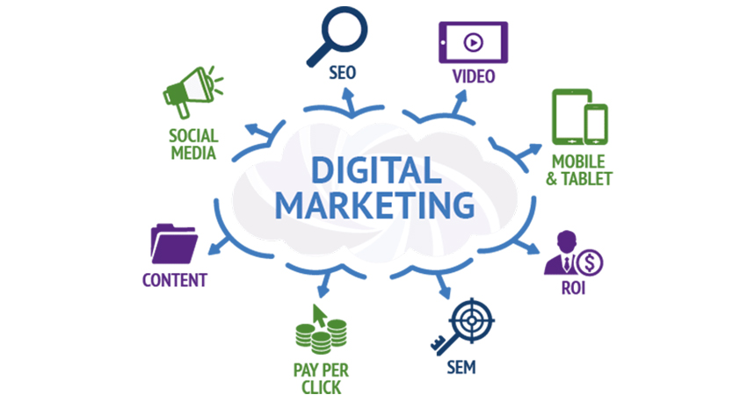
Project 5: Create an Adwords Campaign-Part 1
Laavanya Ganesh
THE ONLY FASHION THAT NEVER DIES

Slide 2

APPROACH DESCRIPTION

Slide 3
Intro to Data Analysis is my free course assigned for my Google Adwords campaign
The preferred audience location is India targeting people who read and write English
The daily budget is $10 and eCPC is $3
Landing page: https://www.udacity.com/course/intro-to-data-analysis--ud170
Basically I segmented my campaign into two groups based on customer journey:
Awareness
Desire

Slide 4
In the Awareness segment, I targeted large audience with more broad and generic keywords to make aware of this Udacity’s free Intro to Data Analysis course. I used Google keyword planner to undergo my keyword research based on my landing page and potential customer. Based on the ads, I discovered my headline and description to be more broad and generic with a key idea to display this course to be opensource.
In the Desire segment, I targeted more specific audience through brand and technical keywords who are looking for data analysis courses. I used Google keyword planner to undergo my keyword research based on my potential customer . Primary objective of this free course is to promote Artificial Intelligence for trading Nano degree so I have used few keywords related to this Nano degree Program. Based on the ads, I discovered my headline and ad copy to target people who are specifically looking for the data analysis and science courses.

Slide 5
MARKETING OBJECTIVE: To Create awareness of Udacity’s Artificial Intelligence for trading Nano degree Program through enrollment of free course – Intro to Data Analysis. Primary Objective is to achieve 10 new enrollments as an outcome of this campaign with a daily budget of 10$ for 5 day
PRIMARY KPI: Primary KPI is number of leads (i.e. Number of new enrollments)

Slide 6
AD-GROUP 1 Awareness-Intro to data analysis-India

Slide 7
KEYWORD LIST
1. data analyst training and placement 2. data science with r online training 3. a data analyst for dummies 4. database analyst training 5. what application would be best for analyzing data 6. tools that can be used to analyze data 7. healthcare data analyst certification 8. simple data analysis 9. healthcare data analytics training 10. data analyst certification training 11. data analyst undergraduate 12. data science 13. world of data analysis 14. data analytics courses in the world 15. free data for analytics 16. statistics needed for data analysis 17. data analysis app 18. where is data analysis 19. healthcare data analyst training 20. big data science training
21. best online analytics programs 22. analytics education online 23. data analysis in science 24. SQL database analysis tools 25. what data analysis to use 26. hadoop data scientist certification 27. Analytics for data 28. database analyst certification 29. data analysis

Slide 8
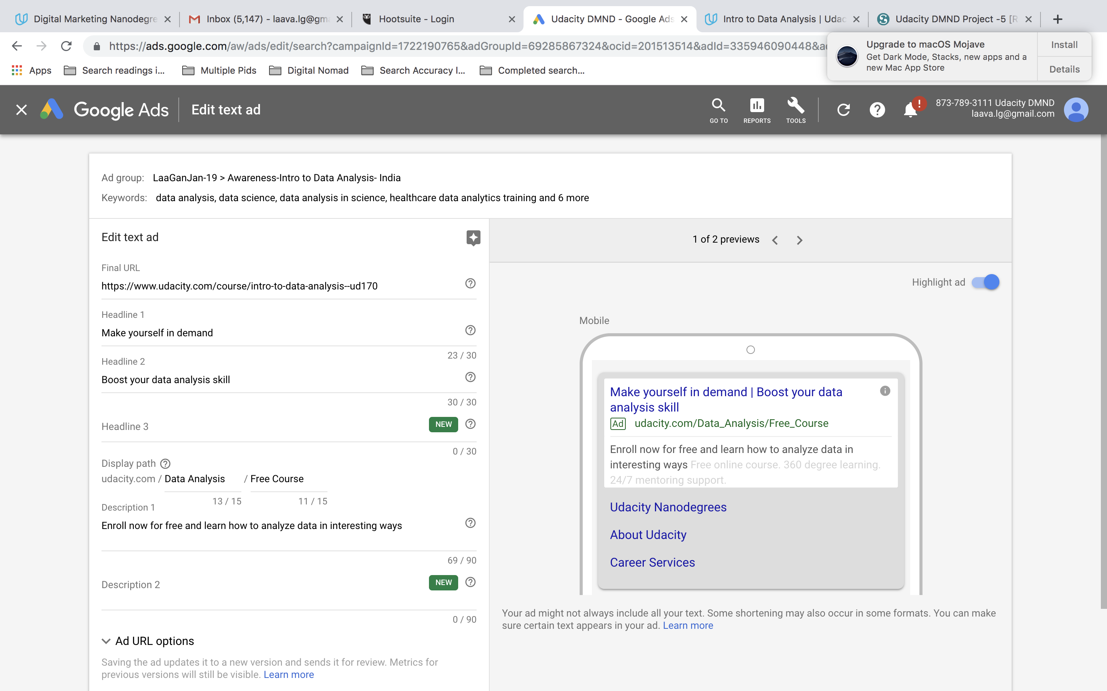
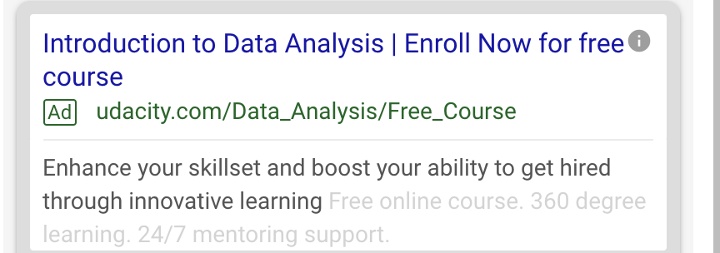

Slide 9
AD-GROUP 2 DESIRE-Intro to data analysis-India

Slide 10
KEYWORD LIST
20. AI undergraduate programs 21. online masters degree artificial intelligence 22. Udacity's data analysis app 23. top universities in artificial intelligence 24. Udacity vs Udemy data analysis 25. artificial intelligence college major 26. Data Analysis online 27. Udacity chatbot course 28. Udacity intro to data analysis 29. Udacity vs course data analysis 30. Udacity analytics for data enthusiasts 31. Udacity's Nanodegree programs 32. best artificial intelligence colleges 33. top artificial intelligence schools 34. Udacity's Intro to data analysis 35. intelligence university courses 36. Udacity masters in robotics and artificial intelligence 37. master's degree artificial intelligence 38. AI schools 39. free data for analytics at Udacity 40. best artificial intelligence graduate programs 41. master of science in artificial intelligence 42. Artificial intelligence 43. Data Analytics Udacity
1. can artificial intelligence learn 2. Udacity advanced artificial intelligence course 3. Udacity Artificial Intelligence for trading Nano degree 4. Udacity for free 5. Udacity Intro to data analysis syllabus 6. artificial intelligence bachelor degree 7. Udacity Intro to data analysis reviews 8. Analysis of data at Udacity 9. MS in robotics and artificial intelligence 10. top AI schools 11. Udacity's free courses 12. Udacity free online data analysis courses 13. artificial intelligence college rankings 14. robotics and artificial intelligence degree 15. Data Science and analytics at Udacity 16. masters degree in artificial intelligence and robotics 17. AI masters program 18. Udacity for data analytics 19. computer engineering artificial intelligence

Slide 11
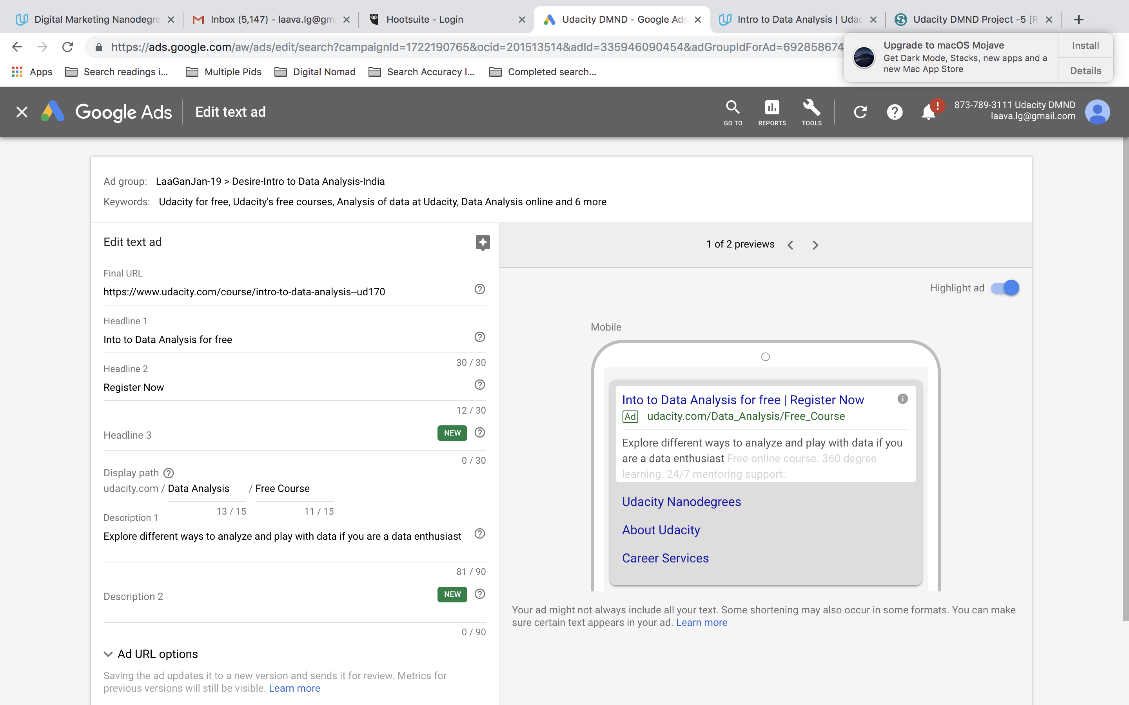


Slide 12
CAMPAIGN SUMMARY

Slide 13
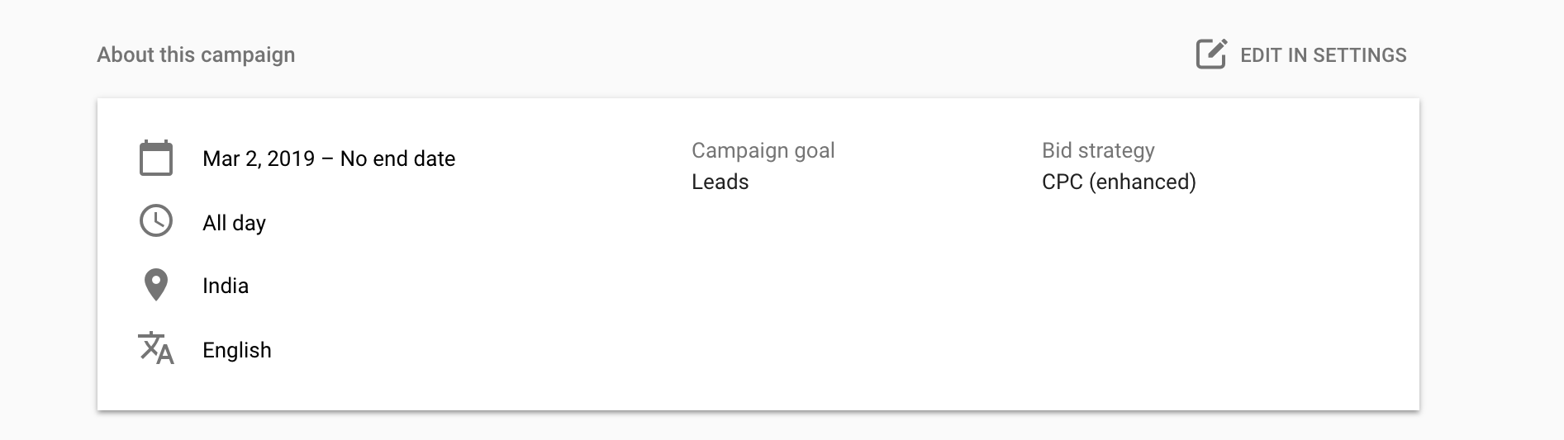

Slide 14
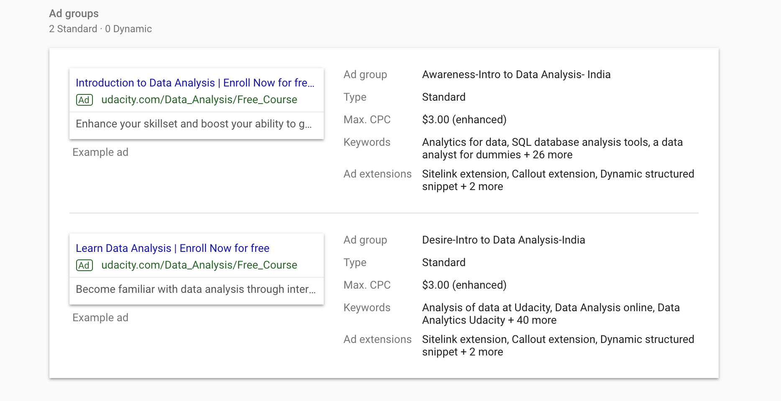

Slide 15
